Slide 1


Simon Grossrieder
December 2022

Slide 2

Outline
Executive Summary
Introduction
Methodology
Results
Conclusion
Appendix

Slide 3
Executive Summary
Summary of methodologies
Get data from different sources (SpaceX API and Wikipedia)
Explore data (Visually, Interactive and Data Wrangling)
prepare data for further analysis
Train predictive classifier models
Summary of all results

Slide 4
Introduction
SpaceX is able to provide cheaper rocket launches due to reused first stages.
For other competitors it would be highly beneficial if they knew whether SpaceX could reuse the first stage or not.
We want to predict if the landing of Falcon 9 first stages will be successful or not using data analysis on different launching parameters.

Slide 5


Slide 6
Methodology
Executive Summary
Data collection methodology:
SpaceX API used to pull data on rocket launches
Web scraping Wikipedia page on Falcon 9 launches and landing outcomes
Perform data wrangling
Create class data indicating mission outcome (which needs to be predicted)
Perform exploratory data analysis (EDA) using visualization and SQL
Perform interactive visual analytics using Folium and Plotly Dash
Perform predictive analysis using classification models
Build models with sklearn, tune them using GridSearchCV and evaluate their score and confusion matrix.

Slide 7
Data Collection
Two datasets were separately imported and prepared for analysis
SpaceX Data
Wikipedia page on Falcon 9 launches
Request Data with SpaceX API
Web scraping on Wikipedia page using Beautiful soup
Convert to Pandas Dataframe
Generate Pandas Dataframe with fetched table data
Data wrangling

Slide 8
Data Collection – SpaceX API
Request launch data in JSON from SpaceX API url.
The content of the Wikipedia page on Falcon 9 launches was wrangled using Beautiful Soup to extract data from the tables on the webpage.
https://github.com/SiGr27/Capstone/blob/main/SpaceX%20Data%20Collection.ipynb
Normalize into pandas dataframe
For each launch request rocket, launch site, payload and core data through SpaceX API
Filter for Falcon 9 boosters
Handle missing values
Mean for missing payloads
Save in CSV file

Slide 9
Data Collection - Scraping
Request HTML content of Wikipadia page on Falcon 9 launches
SpaceX API was used to request data on past SpaceX rocket launches
https://github.com/SiGr27/Capstone/blob/main/SpaceX_WebScraping.ipynb
Create a Bueatiful Soup object of content
Extract all tables
From the first launch table get columns and prepare launch dictionary
Fill dictionary going through each table and extracting the data
Create dataframe from dictionary and save into CSV file

Slide 10
Data Wrangling
Load CSV file with the previously stored data into a dataframe
Applying some basic operations on the dataframe to get some first insights on the Falcon 9 launches.
Transform data for further processing.
https://github.com/SiGr27/Capstone/blob/main/SpaceX_Data%20Wrangling.ipynb
Get Number of launches per site
Get Number of launches into each orbit
Count Mission outcomes per orbit
Create a Class label indicating the mission outcome as 0 = bad; 1 = successful
Save in CSV file

Slide 11
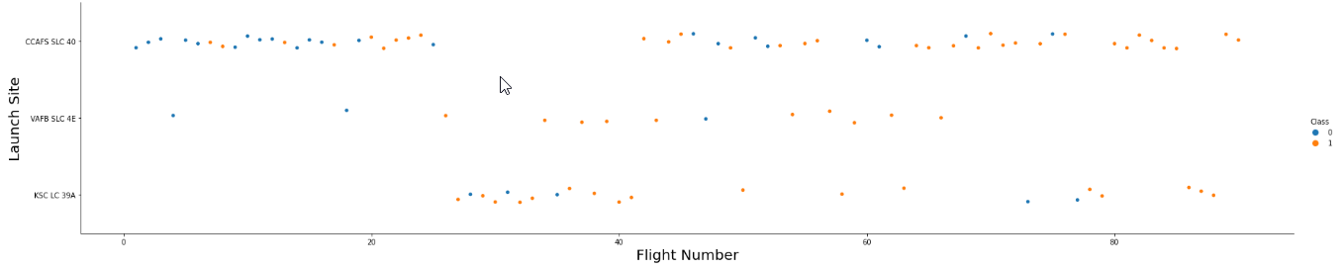
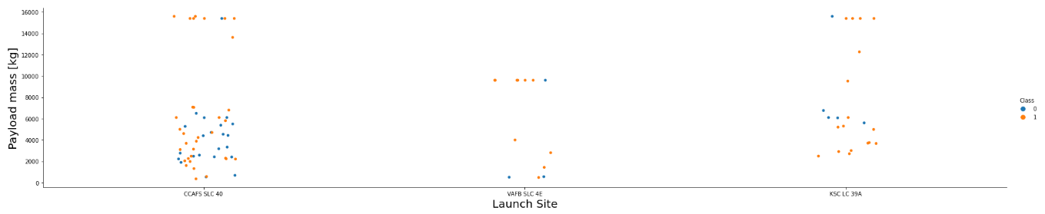
EDA with Data Visualization
Use a scatter plot to depict how the flight number and Launch sites have an impact on the mission outcome
Use a scatter plot to depict how the payload and launch sites have an impact on the mission outcome
https://github.com/SiGr27/Capstone/blob/main/EDA_with_Visualization.ipynb

Slide 12
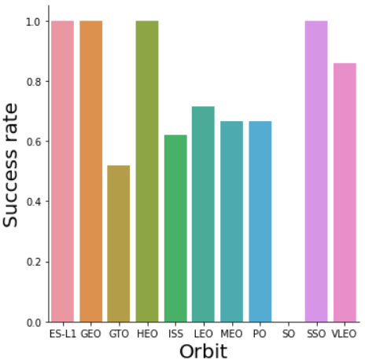
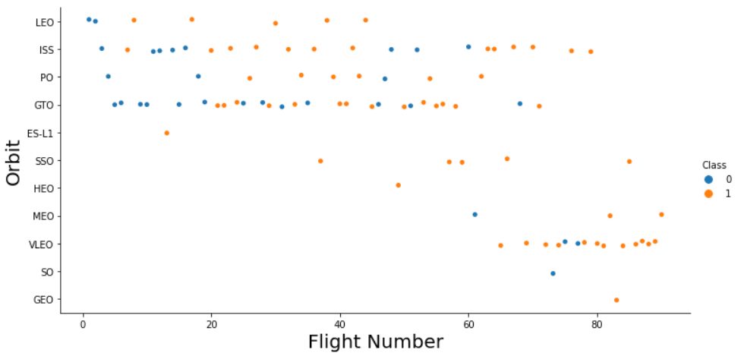
EDA with Data Visualization
Use a bar chart to depict the success rate for each orbit
Use a scatter plot to depict which orbit was targeted along the flights and how successful the missions were
https://github.com/SiGr27/Capstone/blob/main/EDA_with_Visualization.ipynb

Slide 13
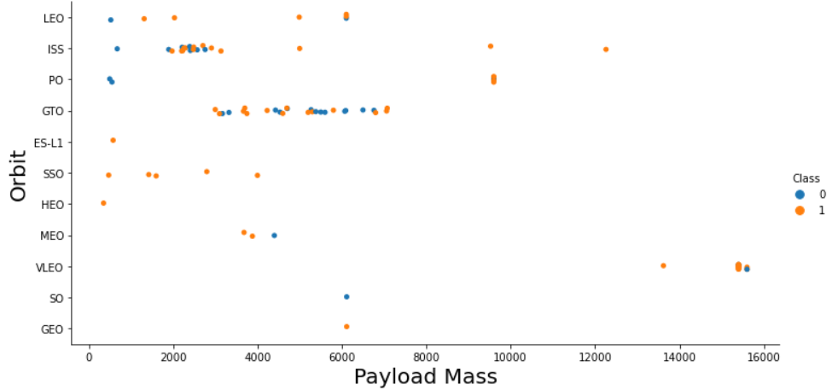
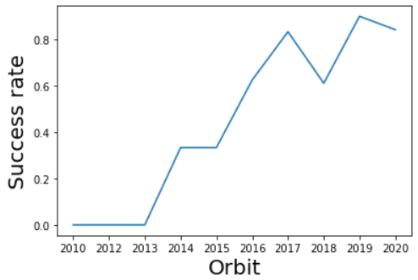
EDA with Data Visualization
Use a scatter plot to depict the payloads sent to each orbit and how successful the missions were.
Use a line plot to depict the evolution of the success rate along the years
https://github.com/SiGr27/Capstone/blob/main/EDA_with_Visualization.ipynb

Slide 14
EDA with SQL
Executed Queries
Display each distinct launch site
Display (5) launches from sites starting with “CCA”
Display the total payload carried for the customer “NASA (CRS)”
Display the total payload carried by the booster “F9 V1.1”
Display the date of the firs successful landing on a ground pad
List boosters that successfully carried a payload between 4 and 6 tons and landed on a drone ship
Count total missions grouped by their outcome
List boosters that have carried the maximum payload mass
List the failed landings on a drone ship in 2015 with the corresponding launch site and booster version
Rank the landing outcome occurrences between 2010-06-04 and 2017-03-20 (descending)
https://github.com/SiGr27/Capstone/blob/main/SpaceX_EDAwithSQL.ipynb

Slide 15
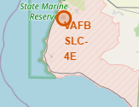
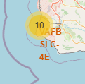
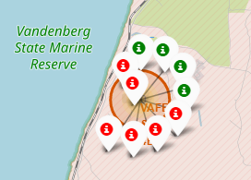
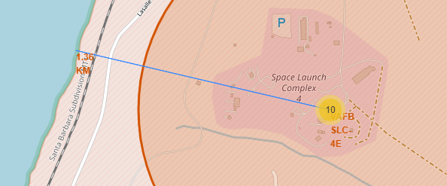
Build an Interactive Map with Folium
Add Circles and Markers to locate the launch sites
Add markers grouped into marker clusters for each launch. The color of the marker should indicate the mission outcome.
Add markers and polylines to indicate distances as e.g. the distance of the launch site to the next coastline.
https://github.com/SiGr27/Capstone/blob/main/Interactive_Visual_Analytics_with_Folium.ipynb

Slide 16
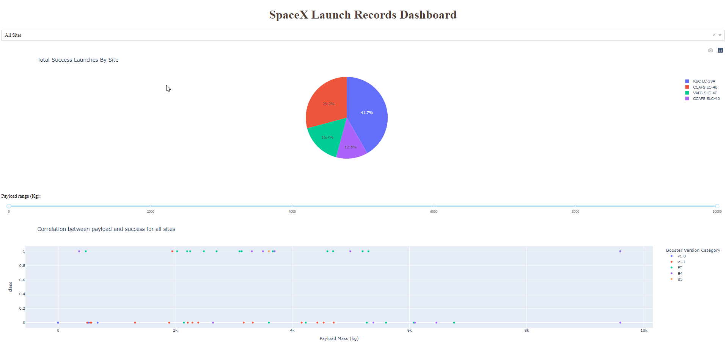
Build a Dashboard with Plotly Dash
Dashboard Elements:
Dropdown selector for the launch site
Pie chart to depict success rate of selected site
Slider to select payload range
Scatter plot indicating mission outcomes for selected payload range and launch site. Marker colors differentiate the booster versions.
https://github.com/SiGr27/Capstone/blob/main/spacex_dash_app.py

Slide 17
Predictive Analysis (Classification)
Train and compare different classification models to select most performant one.
Data read from CSV file into dataframe
Train different models:
Logistic regression
Support Vector Machine
Decision Tree
K nearest neighbor
Assign Class to result variable Y
Assign input data to variable X and standardize using Standard Scaler
Find optimal parameters for each model using GridSearchCV
Split data into training and test sets (test size 0.2)
Compare models by their score and their confusion matrix
https://github.com/SiGr27/Capstone/blob/main/Machine%20Learning%20Prediction.ipynb

Slide 18
Results
Exploratory data analysis results
Interactive analytics demo in screenshots
Predictive analysis results

Slide 19


Slide 20
Flight Number vs. Launch Site
In the beginning there were quite a lot of unsuccessful missions. Up from the 20th mission the success rate became quite good.
Most of the first missions were launched from CCAFS SLC40. As soon most of the missions were successful the other sites were used as well

Slide 21
Payload vs. Launch Site
VAFB SLC 4E was not used for high payload launches
The payload does not seem to have an impact on the success of the mission.

Slide 22
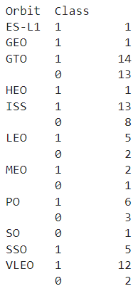
Success Rate vs. Orbit Type
Some of the orbit have 100% success so far, but these were rarely targeted.
The more often targeted orbits have comparable rates around 50% to 70%

Slide 23
Flight Number vs. Orbit Type
In the starting phase, mostly LEO, ISS, PO and GTO were targeted.
During the last flights the VLEO was regularly targeted.
The success is more impacted by the flight number than the orbit.

Slide 24
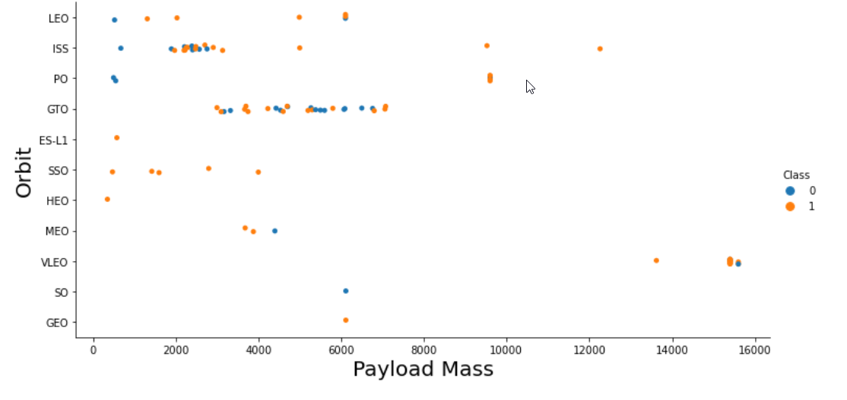
Payload vs. Orbit Type
ISS orbit has a higher success rate with high payloads.
GTO orbit has a lower success rate with high payloads
For the other orbits there is no obvious correlation observable.

Slide 25
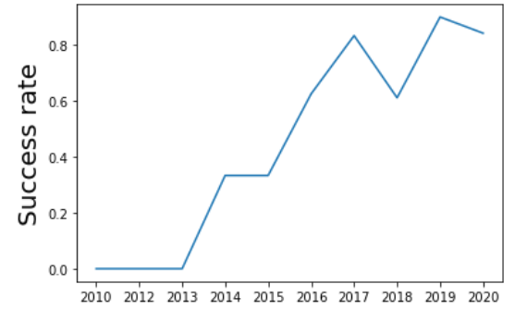
Launch Success Yearly Trend
A positive trend of the success rate over the years is clearly visible.
The only remarkable decrease of the average success rate happened in 2018.

Slide 26
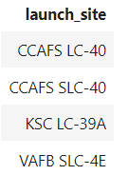
All Launch Site Names
4 launch sites were used for SpaceX launches

Slide 27
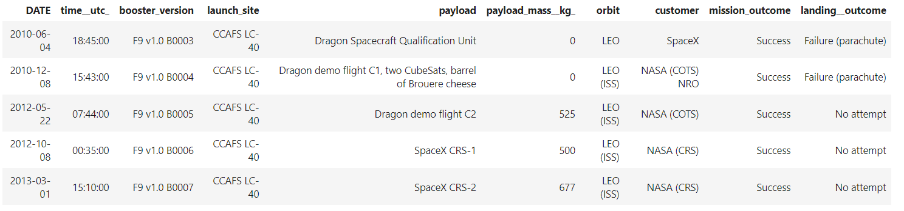
Launch Site Names Begin with 'CCA'
These 5 launches from CCAFS LC-40 happened in the early years of the SpaceX program
The missions were all successful, but none of the landings.

Slide 28
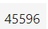
Total Payload Mass
SpaceX transported about 46 tons of material and equipment in the space for NASA CRS.

Slide 29
Average Payload Mass by F9 v1.1
An average payload transported by F9 v1.1 booster weights 2928 kg

Slide 30
First Successful Ground Landing Date
The first successful landing on a ground pad happened on December 22th, 2015

Slide 31
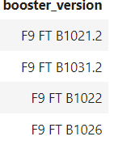
Successful Drone Ship Landing with Payload between 4000 and 6000
The above listed boosters have successfully landed on drone ship and had payload mass greater than 4000 but less than 6000

Slide 32
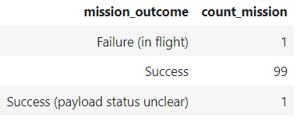
Total Number of Successful and Failure Mission Outcomes
With 1 only failure in flight, SpaceX has a very high mission success rate.

Slide 33
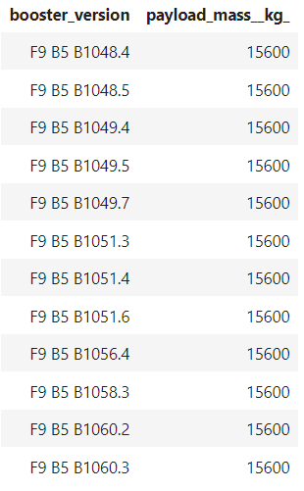
Boosters Carried Maximum Payload
Boosters F9 B5 were used for max payload flights.
The maximum carried payloads is 15.6 tons

Slide 34
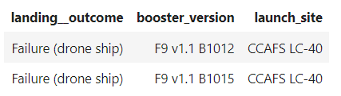
2015 Launch Records
In 2015 two landing attempts on a drone ship failed.
Both were launched from CCAFS LC-40 with a booster F9 v1.1

Slide 35
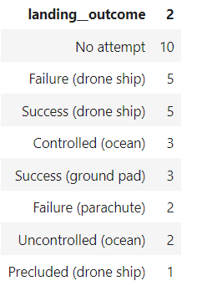
Rank Landing Outcomes Between 2010-06-04 and 2017-03-20
In the mentioned time period
1 third of the boosters had no landing attempts
1 third of the boosters were attempted to land on a drone ship

Slide 36


Slide 37
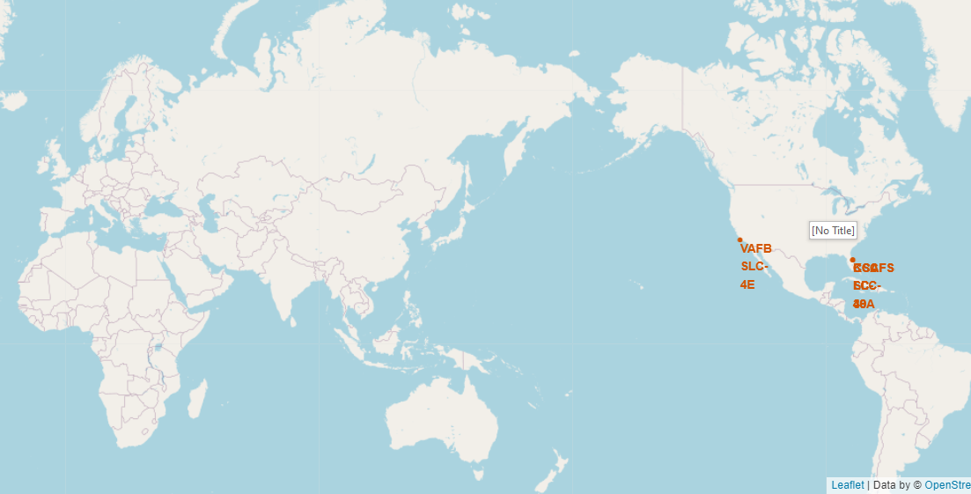
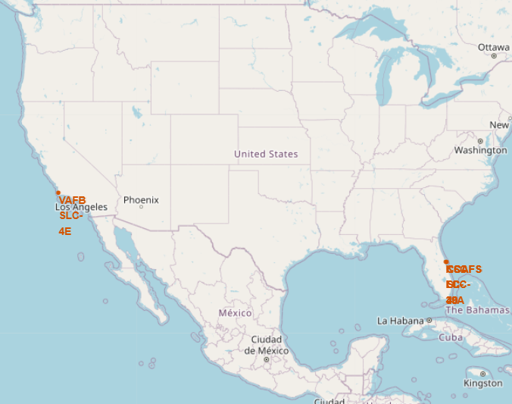
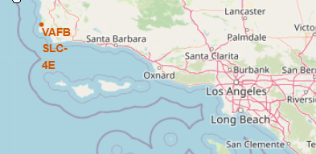
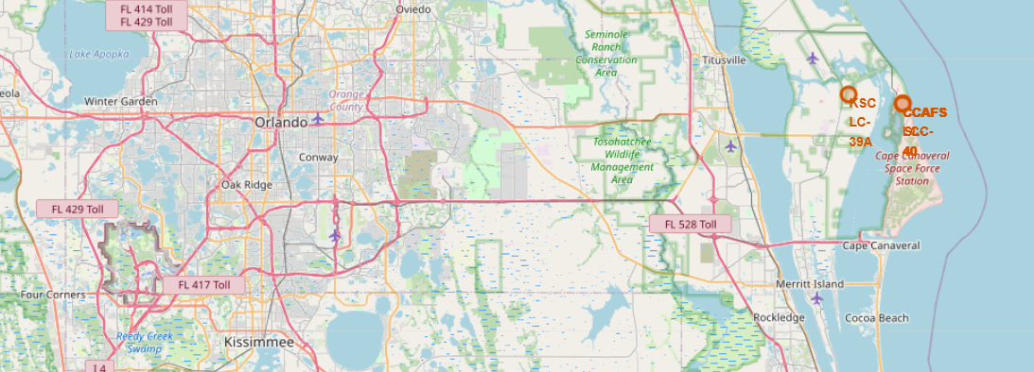
Locations of the launch sites
All launch sites are located in the United States of America
1 launchsite is near LA California
3 launch sites are near Orlando Florida

Slide 38
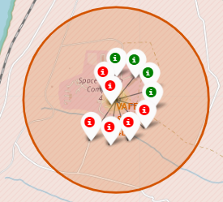
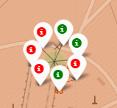
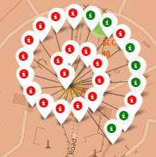
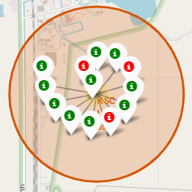
Launch outcomes of each site
VAFB SLC-4E
CCAFS LC-40
CCAFS SLC-40
KSC LC-39A
KSC LV-39A has the highest success rate
Most launches happened from CCAFS SLC-40

Slide 39
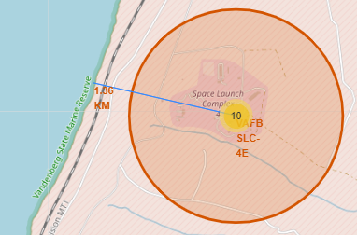
Coastline distance of VAFB SLC-4E
VAFB SLC-4E is located 1.36 km apart from the ocean.

Slide 40


Slide 41
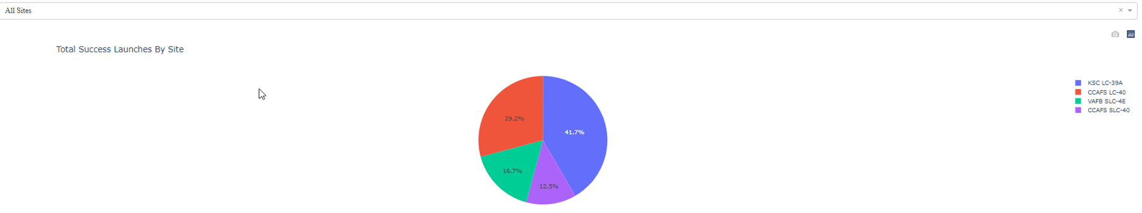
Successful Launches per Site
Most of the successful launches have been launched from KSC-LC-39A

Slide 42
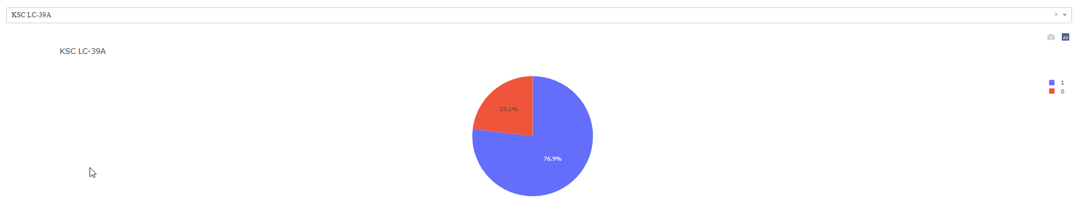
Most successful launch site
More than 3 out of 4 launches from KSC LC-39A are successful

Slide 43
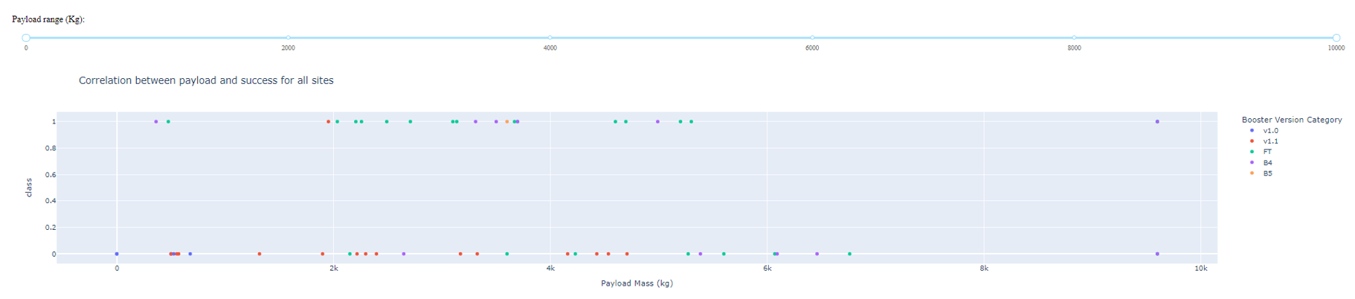
Payload vs. Launch Outcome
Payload does not have a direct impact on a successful mission
Booster V1.0 and V1.1 were still quite unsuccessful where the other versions became more reliable.

Slide 44


Slide 45
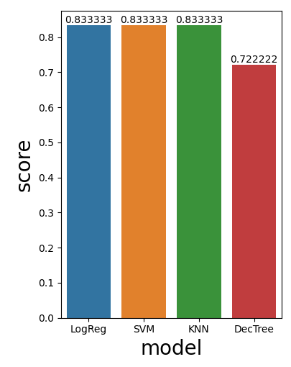
Classification Accuracy
Decision tree performed the worst
All other models performed equally well on the test data.

Slide 46
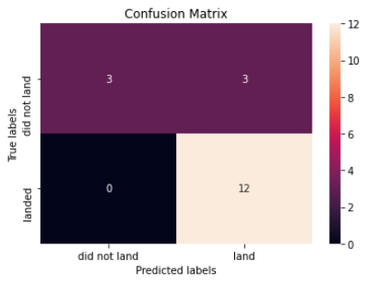
Confusion Matrix
This is the confusion matrix of the logistic regression model.
There are 3 false positives in the predictions of the testdata

Slide 47
Conclusions
About 83% prediction accuracy can be expected.
The models all tend to predict some false positives.
More samples would allow to tune the models.

Slide 48
Appendix
Notebooks, data and code are available on GitHub:
Data Collection | https://github.com/SiGr27/Capstone/blob/main/SpaceX%20Data%20Collection.ipynb
Web Scraping | https://github.com/SiGr27/Capstone/blob/main/SpaceX_WebScraping.ipynb
Data Wrangling | https://github.com/SiGr27/Capstone/blob/main/SpaceX_Data%20Wrangling.ipynb
EDA with data visualiztaion | https://github.com/SiGr27/Capstone/blob/main/EDA_with_Visualization.ipynb
EDA with SQL | https://github.com/SiGr27/Capstone/blob/main/SpaceX_EDAwithSQL.ipynb
Machine learning prediction | https://github.com/SiGr27/Capstone/blob/main/Machine%20Learning%20Prediction.ipynb

Slide 49


